Slide 1

MACHINE LEARNING
(OR DATA SCIENCE)
IN PRODUCTION

Slide 2

I am Julien Nyambal
A Data Scientist | Software Developer
PhD Student and Part-Time Lecturer (Computer Science)

Slide 3
CONTENT
What to expect from this talk!
This talk is not about ...
Proving the math's behind Machine Learning algorithms
How to interpret a Machine Learning model
Teaching you basics of Machine Learning or Data Science
What is Machine Learning?
Data Science is a nutshell
What is MLOp’s and how does it fit in?
Use Case Scenario

Slide 4
WHAT IS MACHINE
LEARNING?

Slide 5
MACHINE LEARNING
This deluge of data calls for automated methods of data analysis, which is what machine learning provides. In particular, we define machine learning as a set of methods that can automatically detect patterns in data, and then use the uncovered patterns to predict future data, or to perform other kinds of decision making under uncertainty (such as planning how to collect more data!)
Machine Learning A Probabilistic Perspective, Kevin P. Murphy, 2013
data
metrics
A computer program is said to learn from experience E with respect to some class of tasks T and performance measure P, if its performance at tasks in T, as measured by P, improves with experience E.
Tom M. Mitchell, Machine Learning, 1997
problem

Slide 6

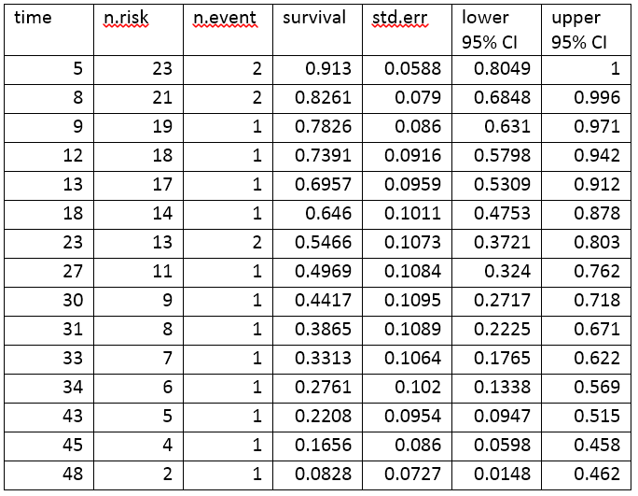
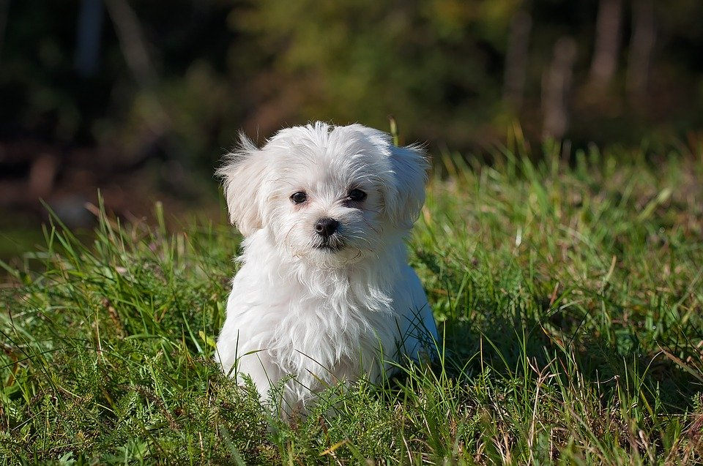


MACHINE LEARNING
Data
f(Data + Noise)
Predictions
Text (Logs, ForEx, )
Audio (Siri)
Images (Facial Recognition)
f -> classifier or model
Noise: little shift added to data
Regression
Classification
Recommendation
Will it rain?
Is it a vehicle?
Should s/he be recommended that movie?

Slide 7
MACHINE LEARNING
Data
Feature Extraction
Learning
Profit
Extract some useful representation/summary of the data for the machine learning algorithm to use.
Collect experience to learn from.
Machine Learning Magic.
$$$$
1
2
3
4

Slide 8


Slide 9
MACHINE LEARNING
Getting data
Using the features
Testing that on some model (In academics, creating a new model and understand the weaknesses of the previous one)
Producing understandable metrics to make decision on a data-model choice
Making that ML model solving a real-word problem is part of Data Science

Slide 10
DATA SCIENCE
IN A NUTSHELL

Slide 11
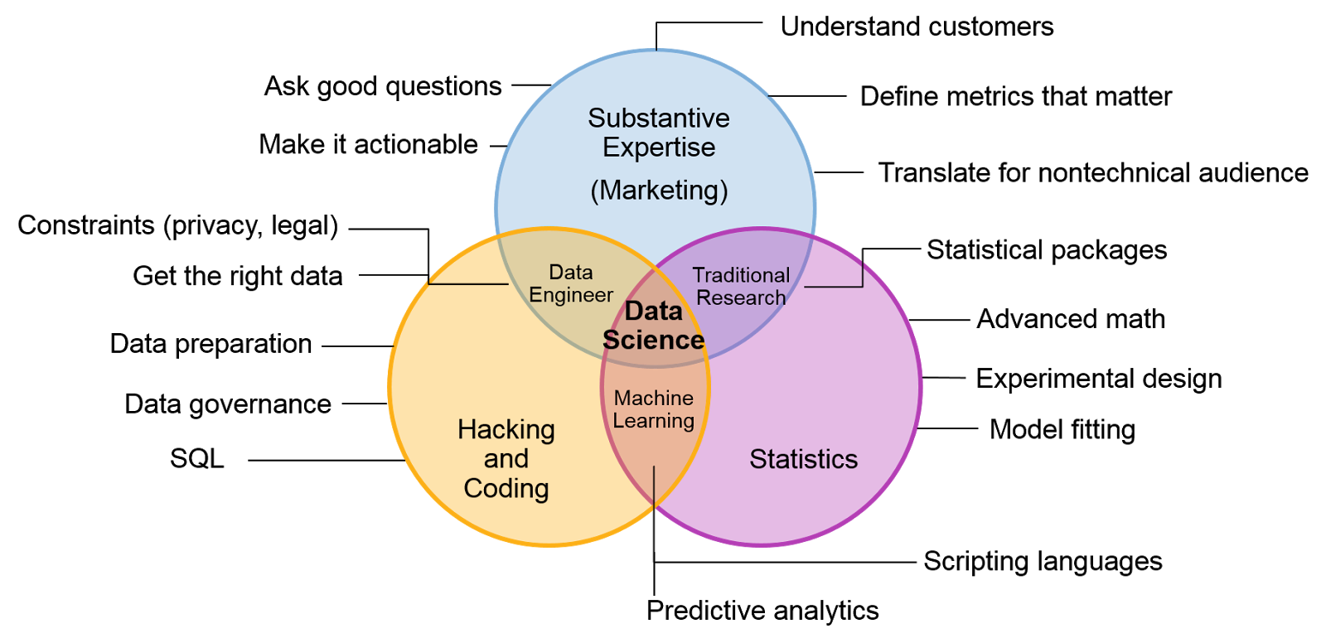

Slide 12
MACHINE LEARNING
Getting the problem to be solved
Defining hypotheses and tests to those hypotheses
Agree with the client about the proposed roadmap
Getting data (After asking many questions...)
Create meaningful features from the problem
Train some models and test the hypothesis above mentioned
Producing understandable metrics to decide on a data-model choice
Making that ML model solving a real-word problem is part of Data Science
Creating a data-driven software
Will hopefully see this guy in production ;-)

Slide 13
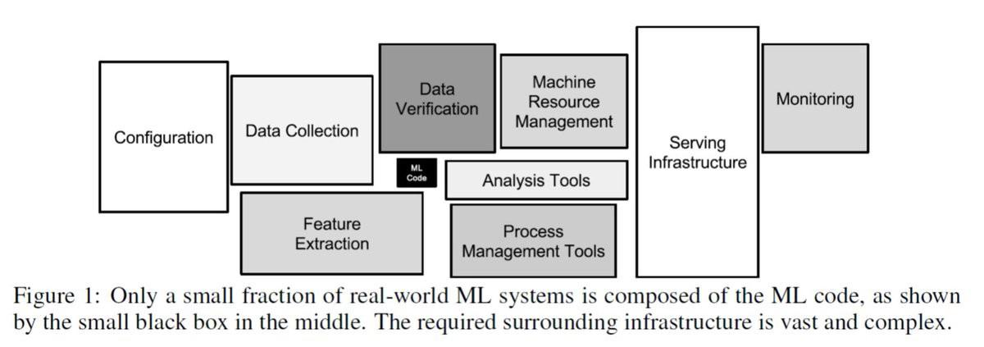
IN REALITY, ML IS IN THE MIDDLE OF A JUNGLE
Data Science
Operations (MLOps)
D. Sculley et al., Hidden Technical Debt in Machine Learning Systems, NIPS 2015

Slide 14
LET’S PUT ALL
OF THIS TOGETHER
WITH A USE CASE

Slide 15
USE CASE
The Client X wants to predict the occupancy of a room based on some sensors’ inputs
The following values are monitored:
Temperature, in Celsius
Relative Humidity, %
Light, in Lux
CO2, in ppm
Humidity Ratio, Derived quantity from temperature and relative humidity, in kgwater-vapor/kg-air
Occupancy, 0 or 1, 0 for not occupied, 1 for occupied status
On top of that, the date of each entry is also recorded in time year-month-day hour:minute:second
Data from https://archive.ics.uci.edu/ml/datasets/Occupancy+Detection+

Slide 16
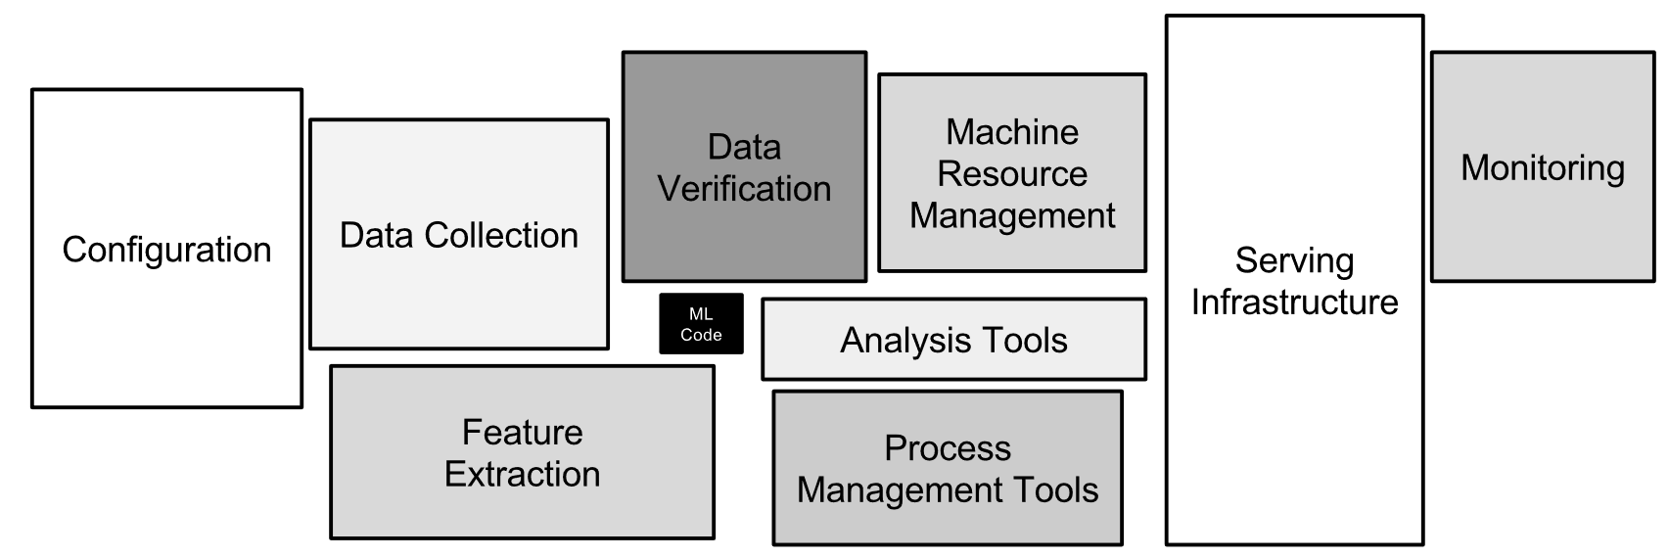
We are HERE

Slide 17
USE CASE: DATA ENGINEERING
Sensors
Temperature
Physical sensor data
Needs to be ingested (Data collection) in a in the system
The transfert should be fast and efficient
This data is mostly unstructured (JSON, AVRO)
A bucket could do (S3 for instance)
CO2
Humidity
Light
Humidity Ratio
Occupancy

Slide 18


USE CASE: DATA ENGINEERING: INGESTION
Sensors
Temperature
CO2
Humidity
Light
Humidity Ratio
Occupancy

Slide 19
USE CASE: DATA ENGINEERING: INGESTION
We like tabular data
It should go to a SQL DB (Relational)
No offense to the MongoDB dev
( ͡° ͜ʖ ͡°)
{
"temperature": 21.01381323950557,
"Humidity": 37.71634137478159,
"Humidity Ratio": 60,
"Light": 1155.6369433701502,
"CO2": 1991.625899943421,
"Occupancy": 1
}
. . .
data.json

Slide 20




USE CASE: DATA ENGINEERING: INGESTION
RDMS
{
"temperature": 21.01381323950557,
"Humidity": 37.71634137478159,
"Humidity Ratio": 60,
"Light": 1155.6369433701502,
"CO2": 1991.625899943421,
"Occupancy": 1
}
. . .
data.json

Slide 21
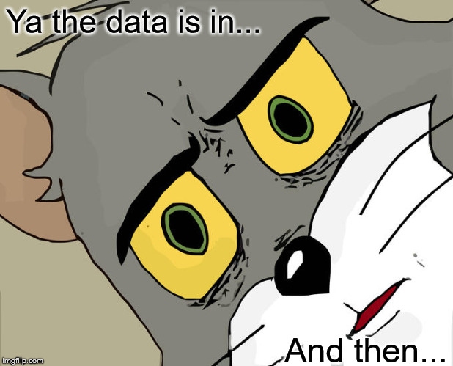
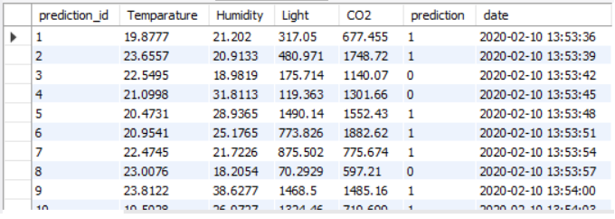
USE CASE: DATA ENGINEERING: INGESTION
RDMS

Slide 22
We are HERE

Slide 23
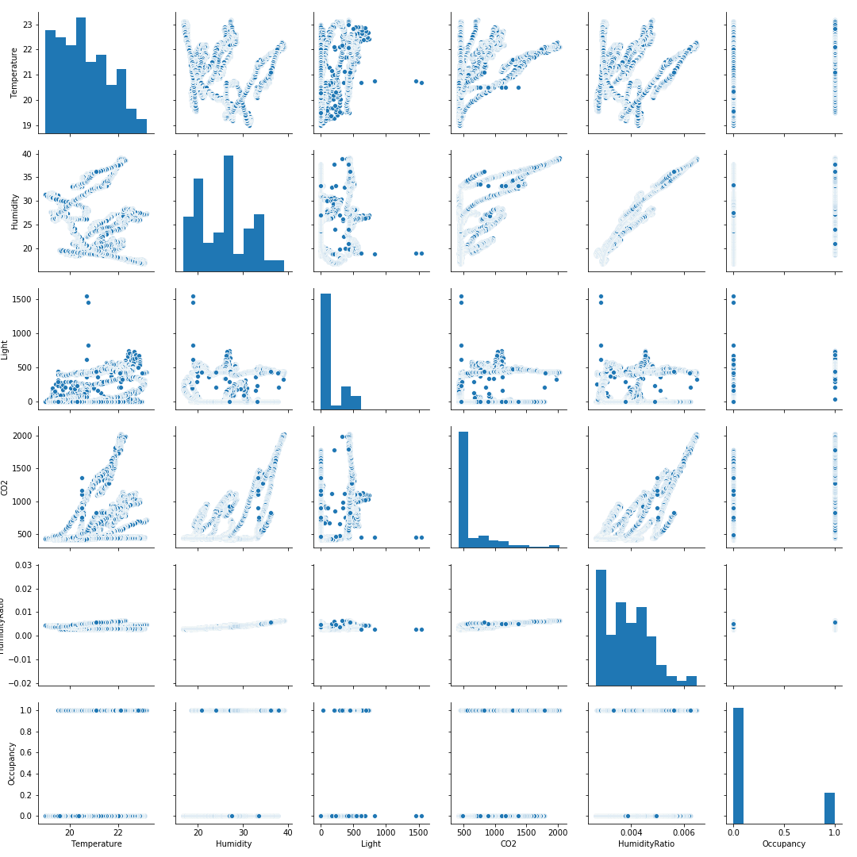
USE CASE: EXPLORATORY DATA ANALYSIS

Slide 24
USE CASE: EXPLORATORY DATA ANALYSIS
Aims:
Better understand the data
Patterns discovery
Correlations
Skewness
Unbalanced data
Feature distributions (Descriptive statistics)
Do the appropriate transformations
Normalization
Raise hypotheses about the potential successes and failures of the prospective model(s)
Data unbalanced -> Biased predictions

Slide 25
We are HERE

Slide 26
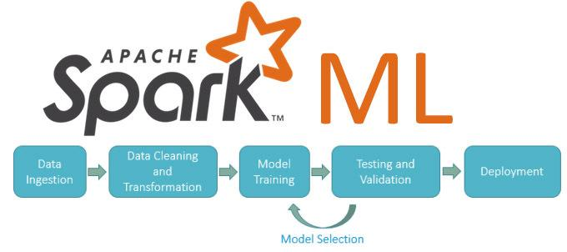
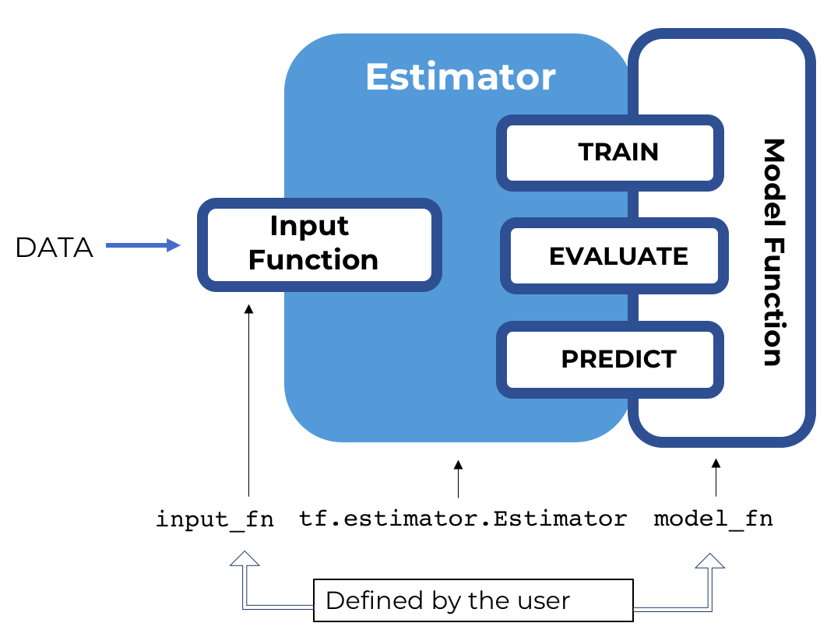
USE CASE: MACHINE LEARNING
ML is now easier because of these packages
TF Extended came into the picture
Scikit Learn is everyone’s best friend
The other ones are good too

Slide 27
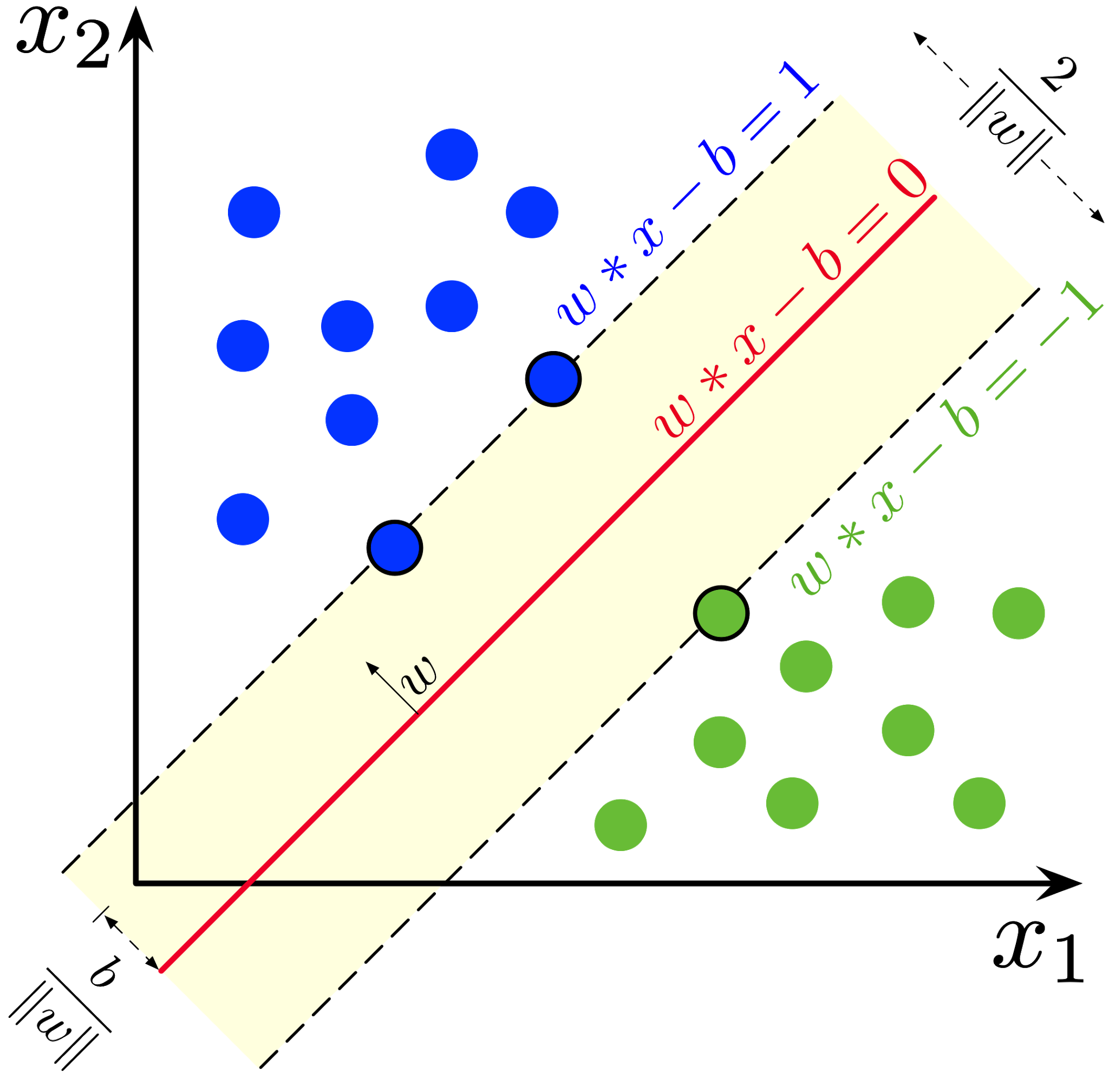
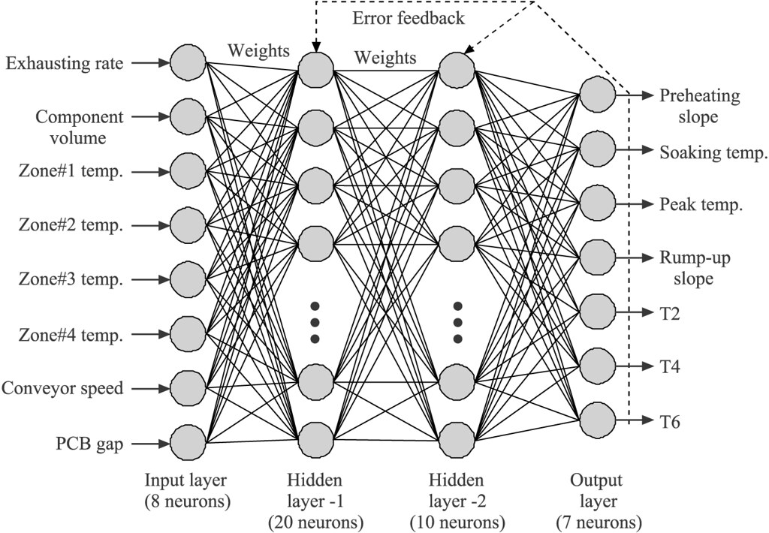
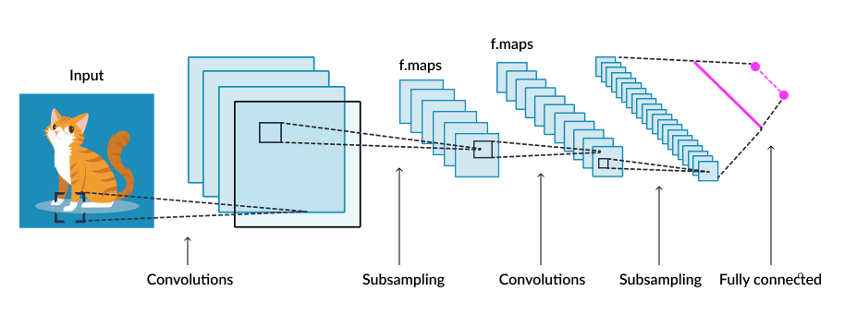

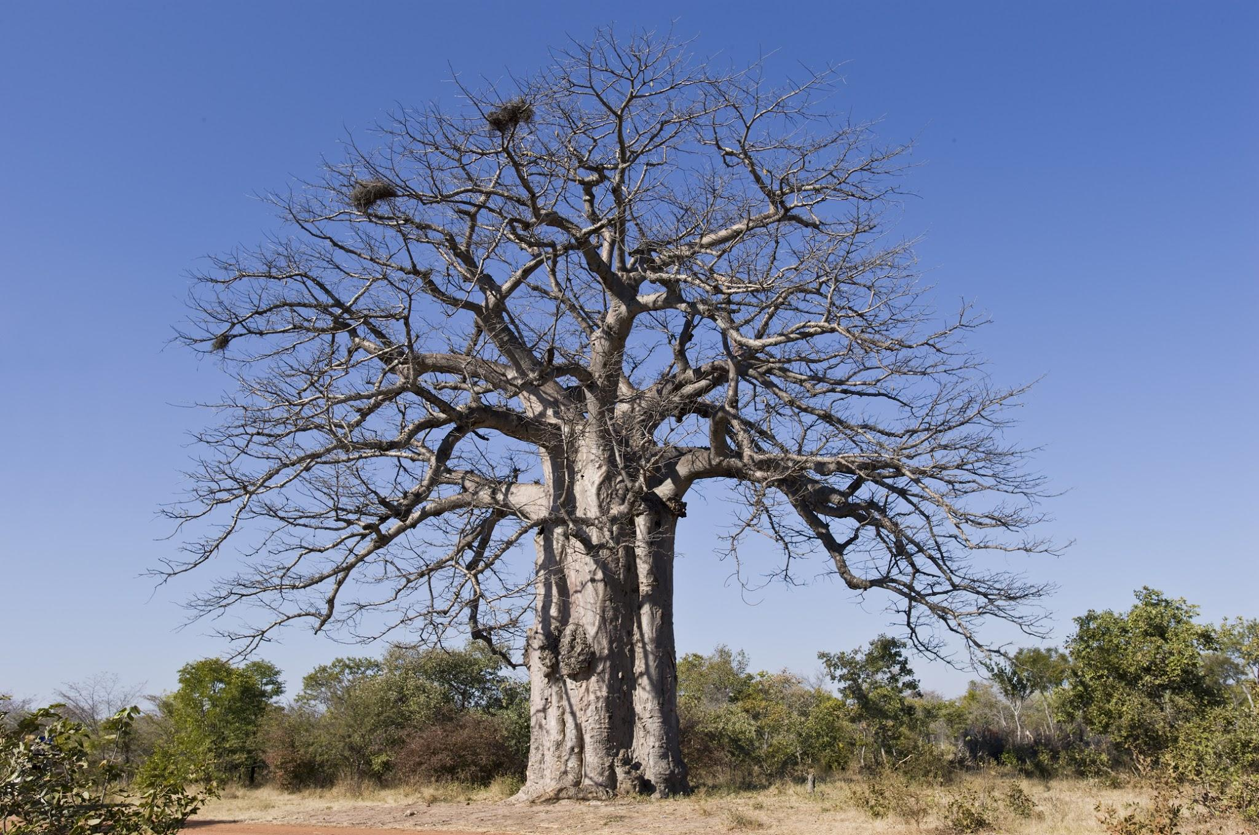
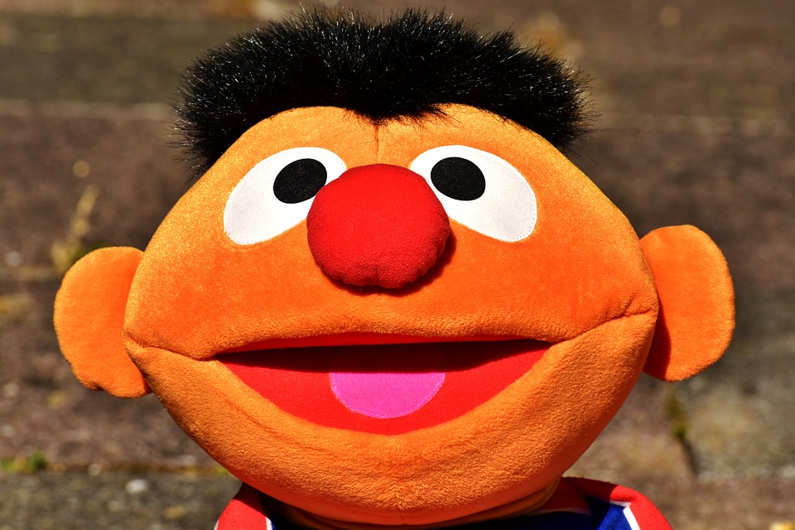
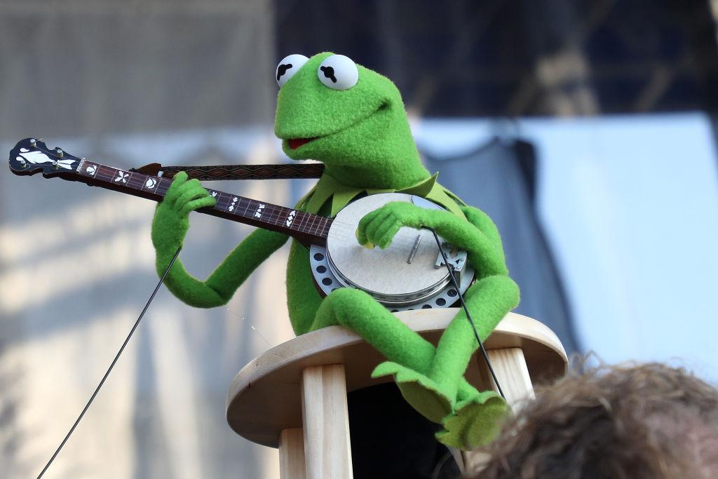
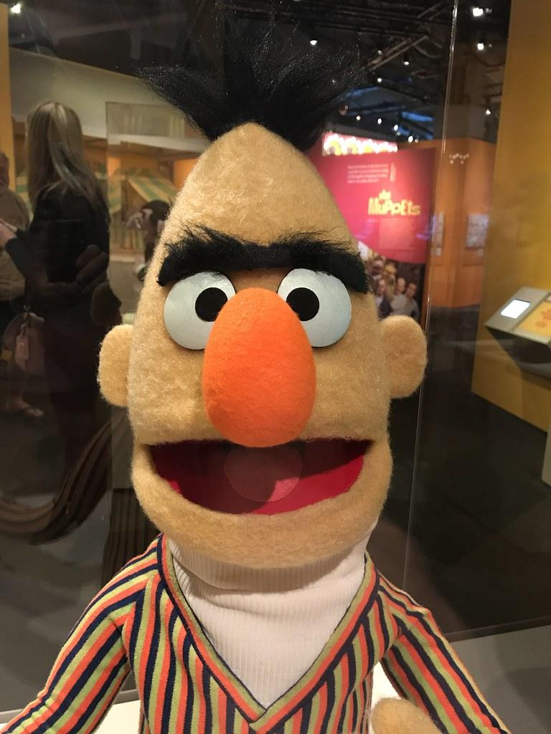
USE CASE: MACHINE LEARNING
Computer Science tree
ERNIE
KERMIT
BERT

Slide 28
USE CASE: MACHINE LEARNING
Aims:
Design Train/Test sets
Choose a best set of estimators (predictors) for the task
Train the model
Producing a baseline
Train with all the features
No regularization
No optimization
Validate the hypothesis,
Is the score greater than baseline?
No: Retrain with tuned hyperparameters
Yes: We have a candidate model

Slide 29
We are HERE

Slide 30



USE CASE: DATA ENGINEERING: INGESTION
Sensors
Temperature
CO2
Humidity
Machine Learning Model
.pkl
Light
Humidity Ratio
Is there anyone in the room?
Occupancy

Slide 31
DEMO

Slide 32
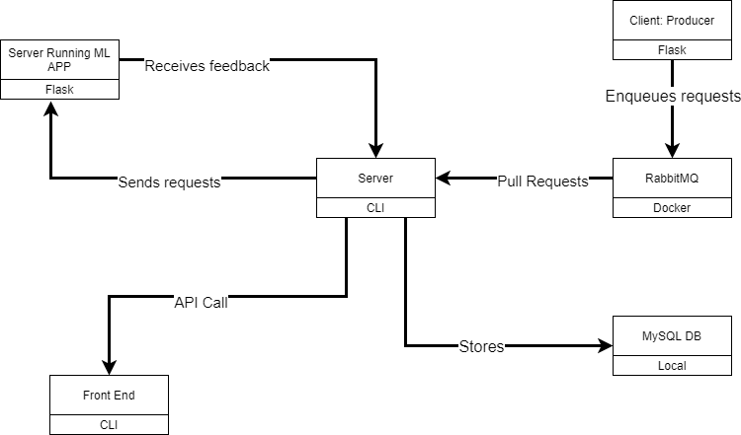
USE CASE: EXPLORATORY DATA ANALYSIS

Slide 33
USE CASE: MACHINE LEARNING MODEL MONITORING
Aims:
Most important than the best ml scores
Check the health of your model
Basic metrics are good, but the business metrics are better: happiness of the client, realistic prices ...
Check the distribution of your production data
Check each features for change of distribution
Seasonality
Trends

Slide 34
USE CASE: DATA ENGINEERING: INGESTION
Sensors
Temperature
CO2
Humidity
Machine Learning Model
.pkl
Light
Humidity Ratio
Is there anyone in the room?
Occupancy

Slide 35
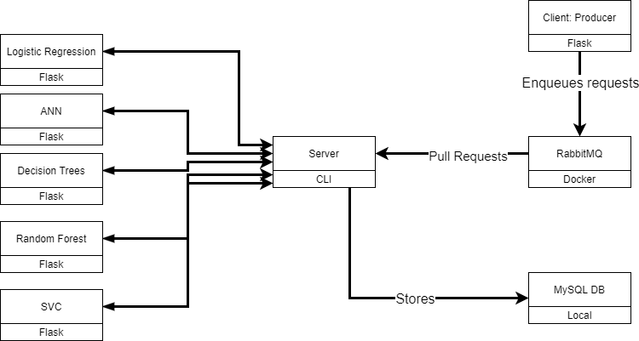
USE CASE: MACHINE LEARNING A/B TESTING

Slide 36
USE CASE: SUMMARY PIPELINE
Sensor data
Data Lake
Data Warehouse
Visualization
Data Collection from Prod
Analysis
Feature Engineering
Serving
Monitoring
Modeling

Slide 37
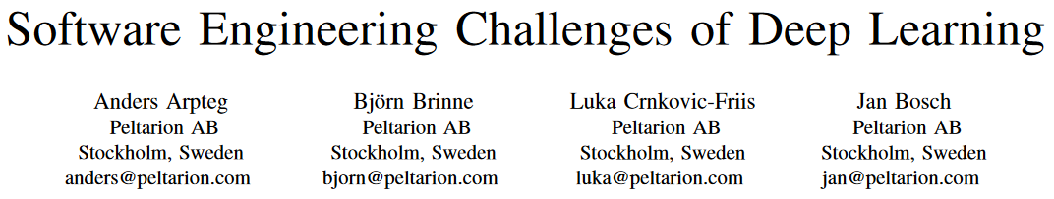
FROM THE PAPER REFERRED TO BELOW
Development Challenges
Reproducibility is an issue due to multiple hyperparameters and the complexity of the data
Hardware configuration can impact the output (GPU, RAM, CPU ...)
Debugging is now a hassle with the rise of big libraries like Apache Spark, Tensorflow and the other, obstructing us to better understand the decision of a model.
Production Challenges:
ML relies on multiple factors, like hardware, software. Daily change make academics happy, and businesses sad because of a change of a specific package (like any other Software Engineering deliverable but at a bigger scale)
Organizational Challenges:
Privacy and Data Safety is a MAJOR issue in the process. Data is the new gold and will be hunted if neglected

Slide 38




SOME SOLUTIONS
Jupyter notebook are ONLY for experiments.
Write python scripts for prod

Slide 39



DATA SCIENCE RE-DEFINITION
Curiosity (Read papers about new models)
Creativity(Try new things)
Inspiration
Patience (Models and Pipelines in prod break a lot, just for fun) ( ͡° ͜ʖ ͡°)

Slide 40
Thank you!!!

